Slide 1
Chapter 4: Collections

Slide 2
Learning Objectives
Collections Overview
Collection Types, Arrays
Sets
Sequence
Maps
Understanding Hashes and Hash Generation
ArrayList and Vectors

Slide 3
Collections in Java
Collections in java is a framework that provides an architecture to store and manipulate the group of objects.
All the operations that you perform on a data such as searching, sorting, insertion, manipulation, deletion etc. can be performed by Java Collections.
Java Collection simply means a single unit of objects. Java Collection framework provides many interfaces (Set, List, Queue, Deque etc.) and classes (ArrayList, Vector, LinkedList, PriorityQueue, HashSet, LinkedHashSet, TreeSet etc).
Collection represents a single unit of objects i.e. a group.
Collection framework represents a unified architecture for storing and manipulating group of objects. It has:
Interfaces and its implementations i.e. classes
Algorithm

Slide 4
Collections Overview
The collections framework was designed to meet several goals, such as −
The framework had to be high-performance. The implementations for the fundamental collections (dynamic arrays, linked lists, trees, and hashtables) were to be highly efficient.
The framework had to allow different types of collections to work in a similar manner and with a high degree of interoperability.
The framework had to extend and/or adapt a collection easily.
Towards this end, the entire collections framework is designed around a set of standard interfaces.
Several standard implementations such as LinkedList, HashSet, and TreeSet, of these interfaces are provided that you may use as-is and you may also implement your own collection, if you choose.
A collections framework is a unified architecture for representing and manipulating collections.
Collections frameworks contain the following −
Interfaces − These are abstract data types that represent collections. Interfaces allow collections to be manipulated independently of the details of their representation. In object-oriented languages, interfaces generally form a hierarchy.
Implementations, i.e., Classes − These are the concrete implementations of the collection interfaces. In essence, they are reusable data structures.
Algorithms − These are the methods that perform useful computations, such as searching and sorting, on objects that implement collection interfaces. The algorithms are said to be polymorphic: that is, the same method can be used on many different implementations of the appropriate collection interface.

Slide 5
Hierarchy of Collection Framework

Slide 6
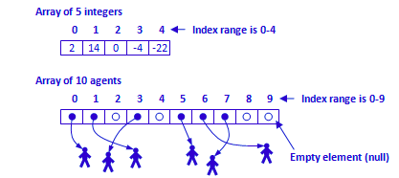
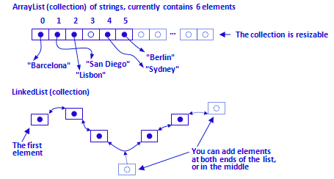
Collection Types Vs Arrays
Java offers two types of constructs where you can store multiple values or objects of the same type: arrays and collections.
Array or collection? Arrays are simple constructs with linear storage of fixed size and therefore they can only store a given number of elements.
Arrays are built into the core of Java language and the array-related Java syntax is very easy and straightforward, for example the nth element of the array can be obtained as array[n-1].
Collections are more sophisticated and flexible. First of all, they are resizable: you can add any number of elements to a collection. A collection will automatically handle deletion of an element from any position. There are several types of collections with different internal storage structure (linear, list, hash set, tree, etc.) and you can choose a collection type best matching your problem so that your most frequent operations will be convenient and efficient.
Collections are Java classes and syntax for obtaining, e.g., the nth element of a collection of type ArrayList is collection.get(n).

Slide 7
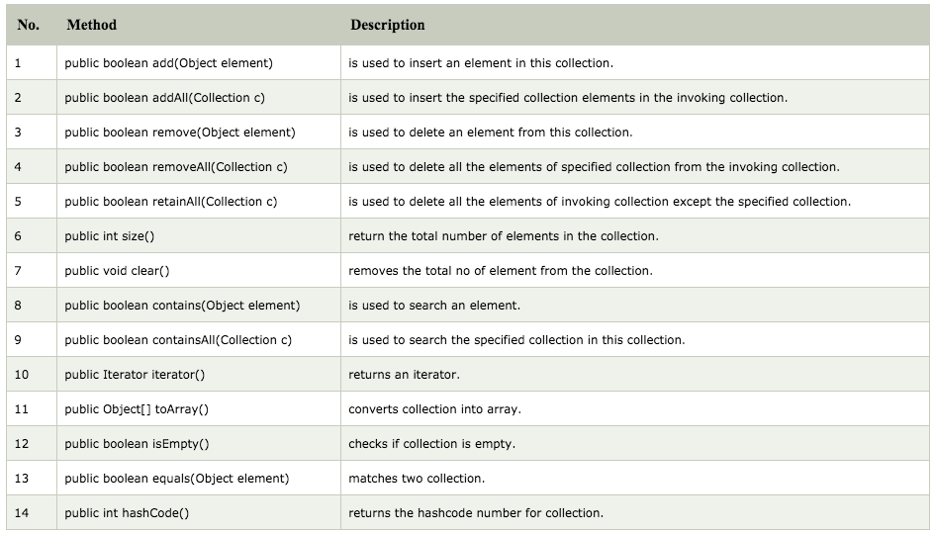
Methods of Collection interface

Slide 8
Sets
A Set is a Collection that cannot contain duplicate elements. It models the mathematical set abstraction.
The Set interface contains only methods inherited from Collection and adds the restriction that duplicate elements are prohibited.
Set also adds a stronger contract on the behaviour of the equals and hashCode operations, allowing Set instances to be compared meaningfully even if their implementation types differ.
General-Purpose Set Implementations:
There are three general-purpose Set implementations — HashSet, TreeSet, and LinkedHashSet. Which of these three to use is generally straightforward. HashSet is much faster than TreeSet (constant-time versus log-time for most operations) but offers no ordering guarantees. If you need to use the operations in the SortedSet interface, or if value-ordered iteration is required, use TreeSet; otherwise, use HashSet. It's a fair bet that you'll end up using HashSet most of the time.
LinkedHashSet is in some sense intermediate between HashSet and TreeSet. Implemented as a hash table with a linked list running through it, it provides insertion-ordered iteration (least recently inserted to most recently) and runs nearly as fast as HashSet. The LinkedHashSet implementation spares its clients from the unspecified, generally chaotic ordering provided by HashSet without incurring the increased cost associated with TreeSet.

Slide 9
Sets
Special-Purpose Set Implementations:
There are two special-purpose Set implementations — EnumSet and CopyOnWriteArraySet.
EnumSet is a high-performance Set implementation for enum types. All of the members of an enum set must be of the same enum type. Internally, it is represented by a bit-vector, typically a single long. Enum sets support iteration over ranges of enum types. For example, given the enum declaration for the days of the week, you can iterate over the weekdays. The EnumSet class provides a static factory that makes it easy.
Enum sets also provide a rich, typesafe replacement for traditional bit flags.
CopyOnWriteArraySet is a Set implementation backed up by a copy-on-write array. All mutative operations, such as add, set, and remove, are implemented by making a new copy of the array; no locking is ever required. Even iteration may safely proceed concurrently with element insertion and deletion. Unlike most Set implementations, the add, remove, and contains methods require time proportional to the size of the set. This implementation is only appropriate for sets that are rarely modified but frequently iterated. It is well suited to maintaining event-handler lists that must prevent duplicates.

Slide 10
Maps
The Map interface maps unique keys to values. A key is an object that you use to retrieve a value at a later time.
General-Purpose Map Implementations:
The three general-purpose Map implementations are HashMap, TreeMap and LinkedHashMap. If you need SortedMap operations or key-ordered Collection-view iteration, use TreeMap; if you want maximum speed and don't care about iteration order, use HashMap; if you want near-HashMap performance and insertion-order iteration, use LinkedHashMap.
In this respect, the situation for Map is analogous to Set. Likewise, everything else in the Set Implementations section also applies to Map implementations.
LinkedHashMap provides two capabilities that are not available with LinkedHashSet. When you create a LinkedHashMap, you can order it based on key access rather than insertion. In other words, merely looking up the value associated with a key brings that key to the end of the map.
Also, LinkedHashMap provides the removeEldestEntry method, which may be overridden to impose a policy for removing stale mappings automatically when new mappings are added to the map. This makes it very easy to implement a custom cache.

Slide 11
Maps
Special-Purpose Map Implementations:
There are three special-purpose Map implementations — EnumMap, WeakHashMap and IdentityHashMap.
EnumMap, which is internally implemented as an array, is a high-performance Map implementation for use with enum keys. This implementation combines the richness and safety of the Map interface with a speed approaching that of an array. If you want to map an enum to a value, you should always use an EnumMap in preference to an array.
WeakHashMap is an implementation of the Map interface that stores only weak references to its keys. Storing only weak references allows a key-value pair to be garbage-collected when its key is no longer referenced outside of the WeakHashMap. This class provides the easiest way to harness the power of weak references. It is useful for implementing "registry-like" data structures, where the utility of an entry vanishes when its key is no longer reachable by any thread.
IdentityHashMap is an identity-based Map implementation based on a hash table. This class is useful for topology-preserving object graph transformations, such as serialization or deep-copying. To perform such transformations, you need to maintain an identity-based "node table" that keeps track of which objects have already been seen. Identity-based maps are also used to maintain object-to-meta-information mappings in dynamic debuggers and similar systems. Finally, identity-based maps are useful in thwarting "spoof attacks" that are a result of intentionally perverse equals methods because IdentityHashMap never invokes the equals method on its keys. An added benefit of this implementation is that it is fast.

Slide 12
Understanding Hashes and Hash Generation
Hashing is a technique used (among other applications) to implement Java's common map and set classes. Hashing is designed to solve the problem of needing to efficiently find or store an item in a collection. For example, if we have a list of 10,000 words of English and we want to check if a given word is in the list, it would be inefficient to successively compare the word with all 10,000 items until we find a match. Hashing is a technique to make things more efficient by effectively narrowing down the search at the outset.
Hashing means using some function or algorithm to map object data to some representative integer value. This so-called hash code (or simply hash) can then be used as a way to narrow down our search when looking for the item in the map.
A hash function that returns a unique hash number is called a universal hash function.
In practice it is extremely hard to assign unique numbers to objects. The later is always possible only if you know (or approximate) the number of objects to be proccessed.
Thus, we say that our hash function has the following properties:
it always returns a number for an object.
two equal objects will always have the same number
two unequal objects not always have different numbers

Slide 13
Understanding Hashes and Hash Generation
Hashing is a technique used (among other applications) to implement Java's common map and set classes. Hashing is designed to solve the problem of needing to efficiently find or store an item in a collection. For example, if we have a list of 10,000 words of English and we want to check if a given word is in the list, it would be inefficient to successively compare the word with all 10,000 items until we find a match. Hashing is a technique to make things more efficient by effectively narrowing down the search at the outset.
Hashing means using some function or algorithm to map object data to some representative integer value. This so-called hash code (or simply hash) can then be used as a way to narrow down our search when looking for the item in the map.
A hash function that returns a unique hash number is called a universal hash function.
In practice it is extremely hard to assign unique numbers to objects. The later is always possible only if you know (or approximate) the number of objects to be proccessed.
Thus, we say that our hash function has the following properties:
it always returns a number for an object.
two equal objects will always have the same number
two unequal objects not always have different numbers

Slide 14
ArrayList and Vectors
The ArrayList class extends AbstractList and implements the List interface. ArrayList supports dynamic arrays that can grow as needed.
Standard Java arrays are of a fixed length. After arrays are created, they cannot grow or shrink, which means that you must know in advance how many elements an array will hold.
Array lists are created with an initial size. When this size is exceeded, the collection is automatically enlarged. When objects are removed, the array may be shrunk.
Vector implements a dynamic array. It is similar to ArrayList, but with two differences:
Vector is synchronized.
Vector contains many legacy methods that are not part of the collections framework.
Vector proves to be very useful if you don't know the size of the array in advance or you just need one that can change sizes over the lifetime of a program.

Slide 15
Iterators
Iterators are used in Collection framework in Java to retrieve elements one by one. There are three iterators.
Enumeration:
It is a interface used to get elements of legacy collections(Vector, Hashtable). Enumeration is the first iterator present from JDK 1.0, rests are included in JDK 1.2 with more functionality. Enumerations are also used to specify the input streams to a SequenceInputStream. We can create Enumeration object by calling elements() method of vector class on any vector object.
Limitations of Enumeration:
Enumeration is for legacy classes(Vector, Hashtable) only. Hence it is not a universal iterator.
Remove operations can’t be performed using Enumeration.Only forward direction iterating is possible.
Iterator:
It is a universal iterator as we can apply it to any Collection object. By using Iterator, we can perform both read and remove operations. It is improved version of Enumeration with additional functionality of remove-ability of a element.
Iterator must be used whenever we want to enumerate elements in all Collection framework implemented interfaces like Set, List, Queue, Deque and also in all implemented classes of Map interface. Iterator is the only cursor available for entire collection framework.
Iterator object can be created by calling iterator() method present in Collection interface.

Slide 16
Iterators
Iterator:
It is a universal iterator as we can apply it to any Collection object. By using Iterator, we can perform both read and remove operations. It is improved version of Enumeration with additional functionality of remove-ability of a element.
Iterator must be used whenever we want to enumerate elements in all Collection framework implemented interfaces like Set, List, Queue, Deque and also in all implemented classes of Map interface. Iterator is the only cursor available for entire collection framework.
Iterator object can be created by calling iterator() method present in Collection interface.
Limitations of Iterator:
Only forward direction iterating is possible.
Replacement and addition of new element is not supported by Iterator.

Slide 17
Iterators
ListIterator:
It is only applicable for List collection implemented classes like arraylist, linkedlist etc. It provides bi-directional iteration.ListIterator must be used when we want to enumerate elements of List. This cursor has more functionality(methods) than iterator.ListIterator object can be created by calling listIterator() method present in List interface.
ListIterator interface extends Iterator interface. So all three methods of Iterator interface are available for ListIterator.
Limitations of ListIterator:
It is the most powerful iterator but it is only applicable for List implemented classes, so it is not a universal iterator.
Important Common Points
Please note that initially any iterator reference will point to the index just before the index of first element in a collection.
We don’t create objects of Enumeration, Iterator, ListIterator because they are interfaces. We use methods like elements(), iterator(), listIterator() to create objects. These methods have anonymous Inner classes that extends respective interfaces and return this class object.

Slide 18
Sequences and Generators
In simple terms, a generator is a function which returns the next value in a sequence.
Unlike an iterator, it generates the next value when needed, rather than returning the next item of a pre-generated collection. Some languages such as Python support generators natively via keywords such as yield. When a generator’s next value is requested in Python, the generator function continues to run until the next yield statement, where a value is returned.
The generator function is able to continue where it left off which can be quite confusing the uninitiated.

Slide 19
Examples: Chapter 4
See COREJ2-Chapter4 at https://github.com/CompleteJavaTraining/JavaEssentials/tree/master/Code/COREJ2-Chapter4

Slide 20
What are we learning in Next Chapter ?
You will learn about Generics & Internationationalization
We will learn about:
Introduction to Generics
Bounded Types
Generics Wildcard
Generic classes, methods and constructors
Java Type Erasure
Introduction to Internationalization and Localization
what is I18N
Localization ad Locale
Locale Class
Date, Time and Currency formatting
Numbers and Measurements localization
Other Formatters

Slide 21
Thank You !

